Slide 1
NLP PROJECT
NLP and Machine Learning Project Disaster Tweet Classification

Slide 2
Objects
Text classification
Feature engineering
Model comparison
Performance evaluation
Introduction
Social media and disaster
Real disaster vs non disaster tweets
Project ka purpose
Data Information
Dataset: 7,613 rows, 5 original columns
Fields: id, keyword, location, text, target
Target 0 = non-disaster; 1 = disaster

Slide 3
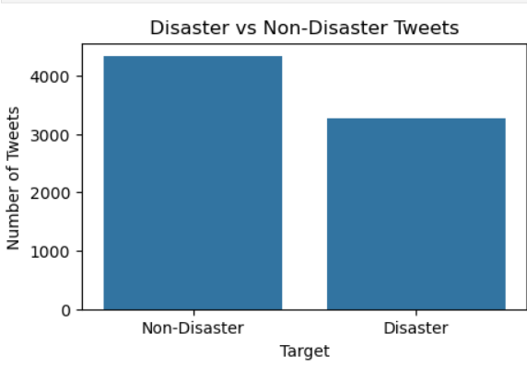
Data visualization
Non-Disaster - 4342
Disaster - 3271
The dataset contains two classes: disaster-related and non-disaster tweets. The target distribution helps us understand whether the dataset is balanced or imbalanced.

Slide 4
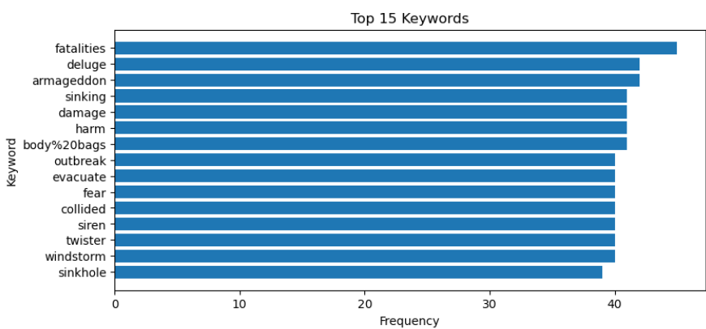
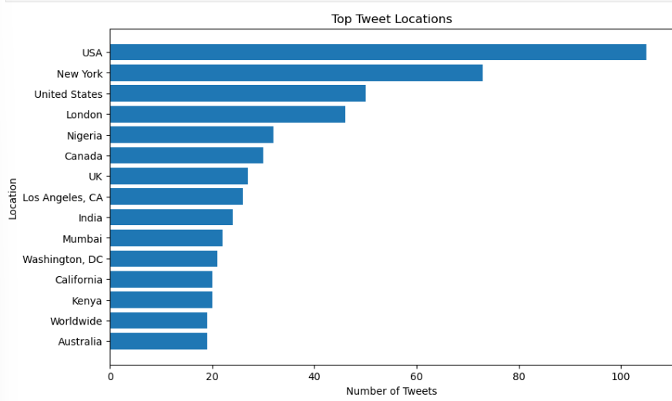
Keyword and Location Analysis

Slide 5
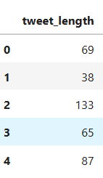
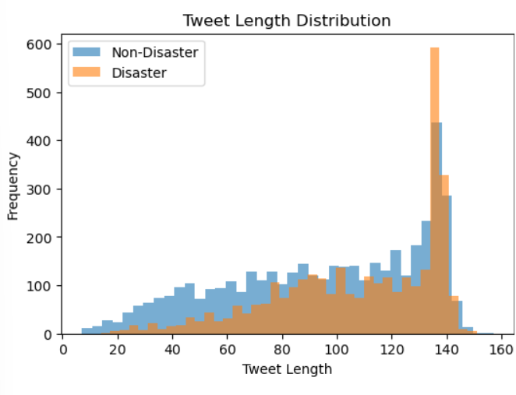
Tweet Length and Word Count

Slide 6
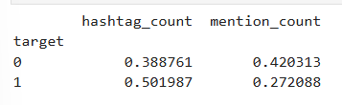
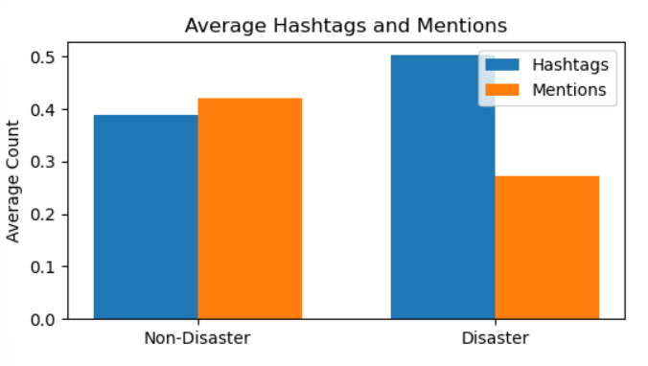
Hastags and Mentions

Slide 7
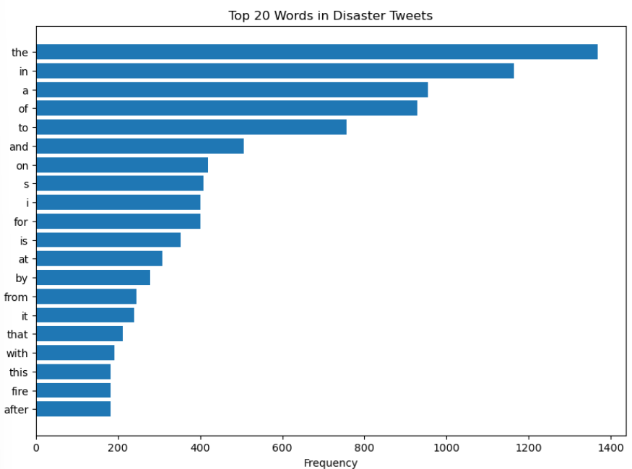
Top Disaster Words

Slide 8
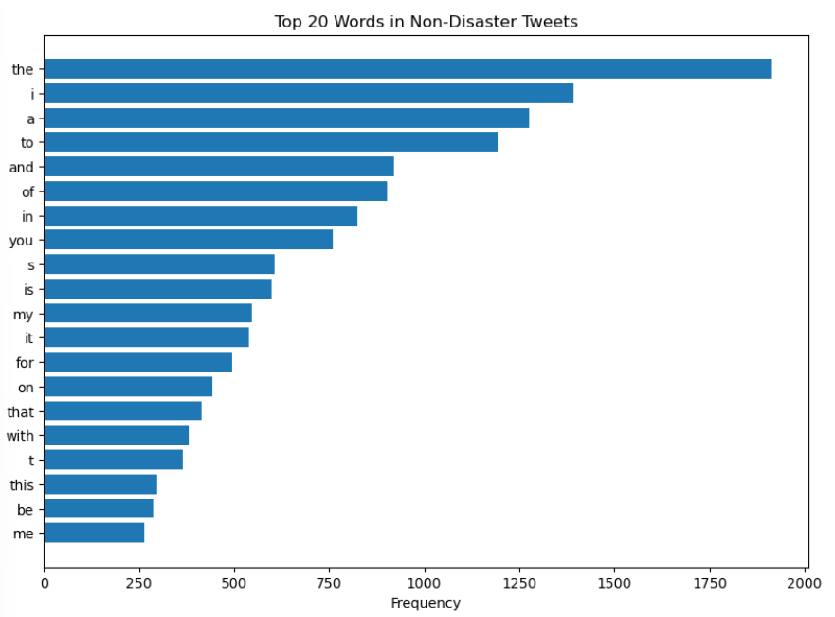
Top Non Disaster Words

Slide 9
TF – IDF and Feature Stacking
Convert text into numerical features
Combine TF-IDF with three additional features
Explain X_train_combined and X_test_combined
Training data: 6090
Testing data: 1523

Slide 10
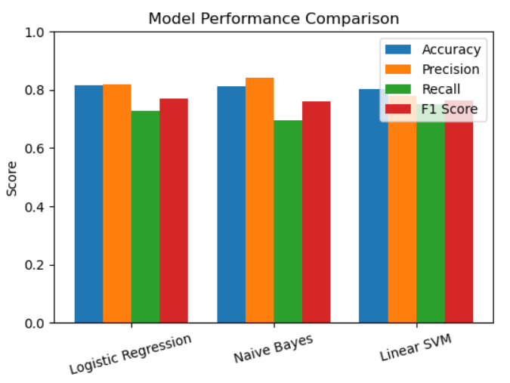
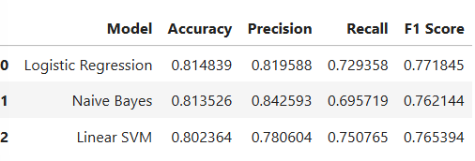
Model Comparison

Slide 11
Classification Report
precision recall f1-score support
Non-Disaster 0.81 0.88 0.84 869
Disaster 0.82 0.73 0.77 654
accuracy 0.81 1523
macro avg 0.82 0.80 0.81 1523
weighted avg 0.82 0.81 0.81 1523

Slide 12
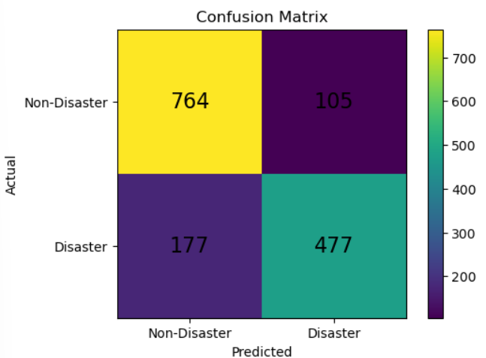
Confusion Matrix

Slide 13
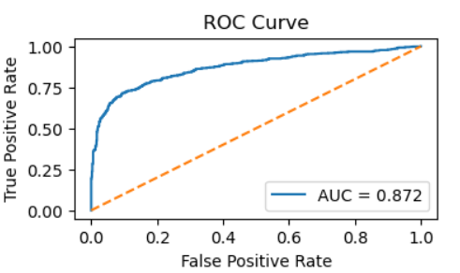
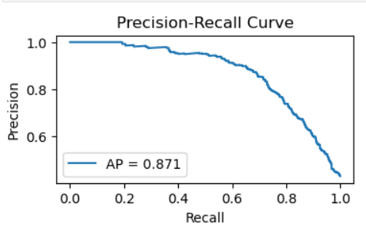
ROC Curve
Precision-Recall Curve
ROC-AUC: 0.871654648916291
Average Precision: 0.8710087812977413

Slide 14
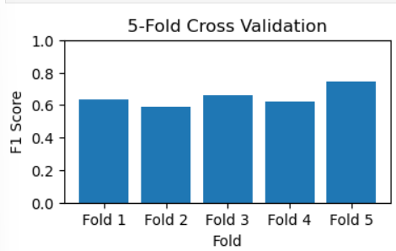
Cross Validation
Cross-validation scores:
[0.63738318
0.58862876
0.65873016
0.61913043
0.74640424]
Mean F1 Score: 0.650055354567477
Standard Deviation: 0.05338262028241877

Slide 15
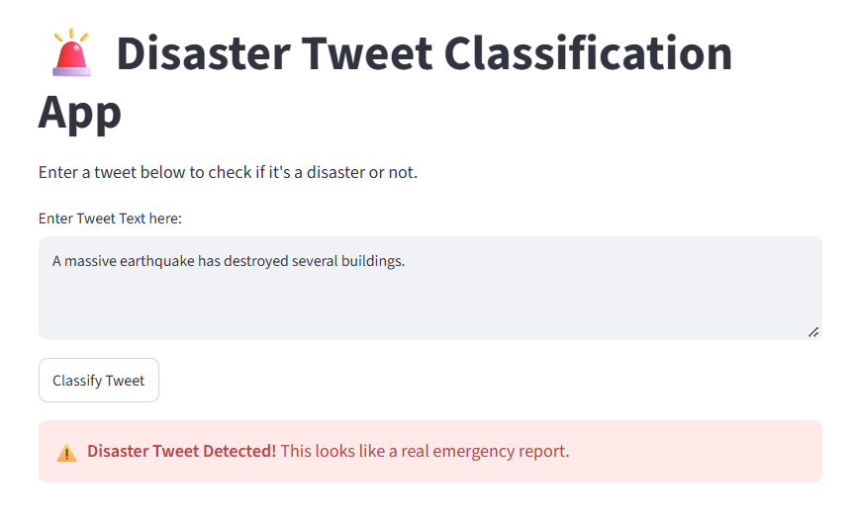
Model Testing and Prediction Result

Slide 16
Deployment
Test Case: Disaster Tweet Classification
Input Tweet: “A massive earthquake has destroyed several buildings.”
Predicted Output: Disaster Tweet Detected!
Interpretation: The trained machine learning model classified the tweet as a possible disaster-related report.
Limitation: The prediction does not verify whether the reported emergency is real.

Slide 17
PRESENTED BY
RUBY SETHI
THANKS

